Slide 1

ATTENDANCE AUTOMATION SYSTEM

Slide 2

Agenda
Project Description
Personas
Technologies Used
System Architecture
Sprint 1-7 Recap
Sprint 8 – Completed tasks & stories
Sprint 8 Deliverable
Sprint 8 Test Cases
Sprint 8 Burndown Chart
Story Points Timeline
Retrospective
Future Scope
Project Links
Project Demo

Slide 3

Project Description
Main purpose of this application is to replace conventional manual attendance method with human interference which consumes lot of time and effort to maintain student attendance.
Our application has been designed to use advanced face detection technique by machine learning algorithm to automate whole process of managing attendance in educational institute
Our application uses camera to capture one’s image compares it with the image stored in database followed by marking attendance.
Instructor will receive an email with a list of students who were absent for a particular class and school admin can immediately view attendance details after each class.
Lastly, our application reduces manual errors by consolidating student attendance which can be revisited and download reports when required making it easier for instructors and admin to manage student attendance.

Slide 4

Attendance Automation System Requirements
Register/Login for admin and faculty
Add Student’s image with details to the database
View Registered Students on GUI Console
Capture student’s image
Upload student’s image (.png/.jpeg files)
Detect and recognize student’s image from database
Generate attendance based on captured/uploaded image
View attendance status of the students on GUI console immediately after attendance is submitted
Download attendance results in excel sheet
Send Automatic Email to the registered faculty with absent students list

Slide 5


Persona
About Professor Riya,
Riya is a 35 years old Professor at Physics teacher at Pace University. I manually take the attendance for all my classes and don’t keep a track of and accidently one of the student was marked absent, he came back to me saying he was present for the class I couldn’t verify it as I don’t keep a track of it.
What can we do ?
Riya can register all the students to the Attendance Automation System and track with separate login details for the faculty and emails after every class.

Slide 6

Persona
About Student Steve,
Steve is a 25 years old Student pursuing masters at Pace University, he attends several classes a day with ample number of students each class and manual attendance would take significant amount of time, he feels there should be an automated attendance system to save class time.
What can we do ?
Steve can simply do a one-time registration with school admin and be present in front of camera while professor is capturing image of students to mark his attendance which avoids him to wait for professor to call out each student’s name and mark attendance.

Slide 7
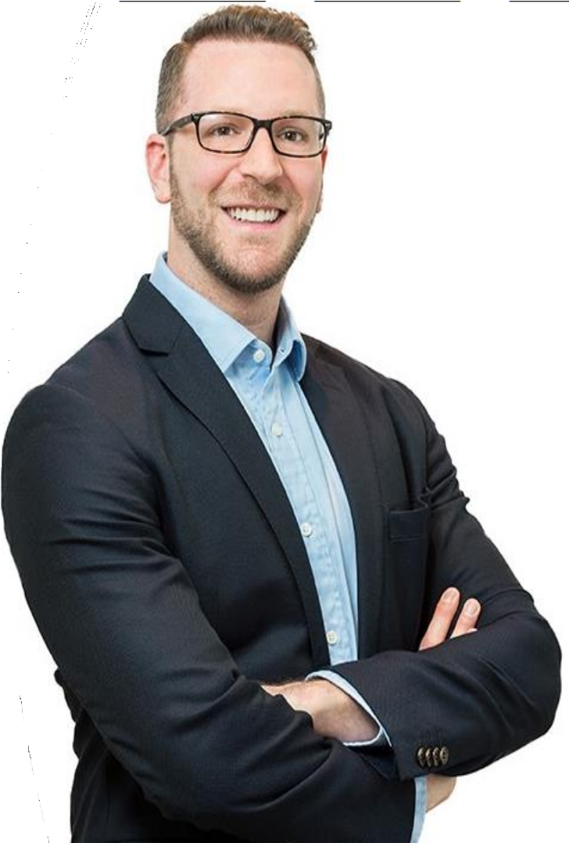
Persona
About University Administrator Jonathan,
Jonathan is a 35-year-old university administrator who keeps track of student’s attendance details at Pace University, he find it difficult to call out every professor after each class to submit attendance details to maintain a track of student attendance data.
What can we do ?
Jonathan can make a one-time effort of registering all the university students to the Attendance Automation System tool which will automatically mark the attendance of all the students present in each professor’s class and keeps a track of all the classes and students without any need to contact each professor after every class.

Slide 8







TECHNOLOGIES USED
PYTHON (BACKEND BUSINESS
LOGIC)
HTML (FRONTEND)
PYQT-5 GUI TOOLKIT (FRONTEND)
CSS (FRONTEND)
MYSQL (DATABASE)

Slide 9
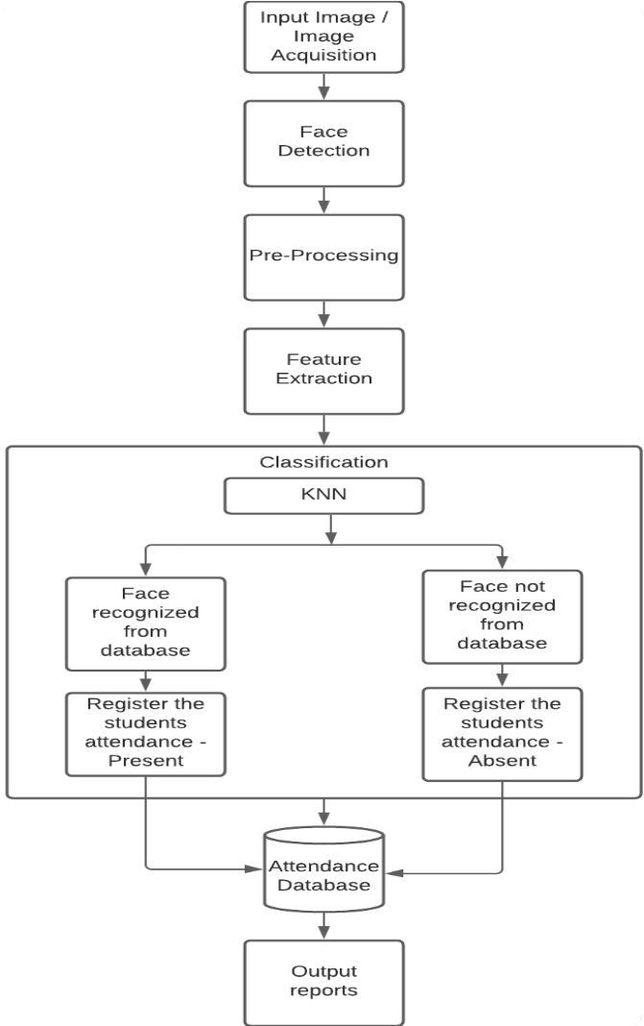
Flow Chart

Slide 10


Sequence Diagram
Login
Register
Students Data
Attendance
Logout
: Admin
: Faculty
1 : Login()
2 : Add/View()
3 : View Reports()
4 : Exit()
5 : New()
6 : Login()
7 : Take()
8 : Exit()

Slide 11


Algorithm Used for face recognition
KNN Machine Learning algorithm is as part of Python’s face recognition library which is used to integrate face detection in our application
KNN is one amongst the best algorithms that may be used for image classification.
It consists of two main phases namely the training phase and the testing phase.
Generating Training Data: The subsequent steps are followed to get training data
- Captures images from your webcam video stream
- Extracts all Faces from the image frame
- Stores the Face information into NumPy arrays
- Read and show video stream, capture images
- Detect Faces and show bounding box
- Flatten the biggest face image (gray scale) and save in a numpy array
- Repeat the above for multiple people to get training data.

Slide 12
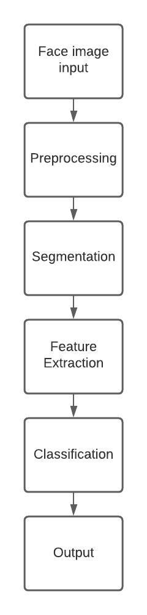
Algorithm used for Face Recognition
Building the Face Classifier
Recognize Faces using the classification algorithm — KNN.
load the training data (NumPy arrays of all the persons)
X - values are stored within the NumPy arrays
Y - values are assigned for every person
Read a video stream using OpenCV
Extract faces out of it
Use KNN to search out the prediction of face
Map the anticipated id to call of the user
Display the predictions on the screen - bounding box and name

Slide 13
Sprints 1-7 Recap:

Slide 14
Sprint 1 Artifacts
Type | Description | Priority | Status | Story Points
US-1 | As an admin/faculty I want to access the options available for login/register into the application so that we can choose if our school admin or faculty wants to login with necessary credentials | Highest | Completed | 8
US-2 | As an admin I want a secure login account page to provide the credentials and login to my account | Highest | Completed | 8
Task | Brainstorm for a significant business application idea | Highest | Completed | N/A
Task | Establish team roles | High | Completed | N/A
Task | Setup development tools and software’s (Python, PyCharm, MySQL, GitHub) | Medium | Completed | N/A
Task | Establish weekly meetings | Medium | Completed | N/A
Task | Design/Search for icons to be used for admin/faculty to be used on homepage | High | Completed | N/A
Task | Create Deliverable 1 Presentation Slides | Medium | Completed | N/A
Number of User Stories completed - 2
Number of Tasks Completed – 6
Artifacts Completed = 100%
Velocity = 16

Slide 15
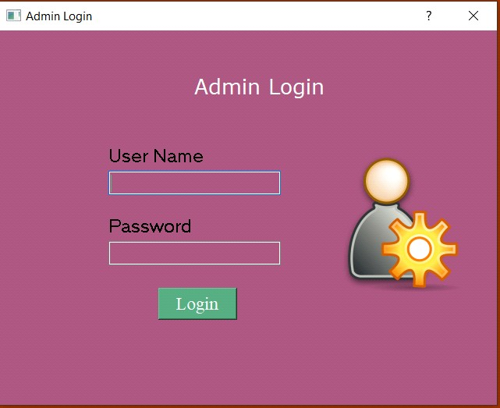
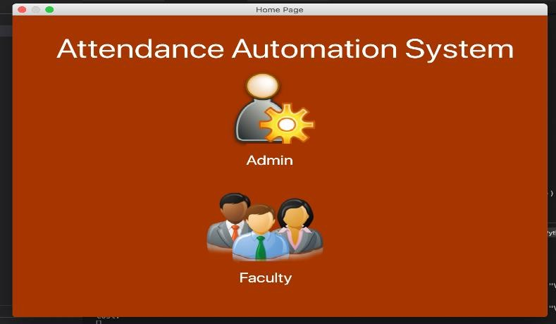
Sprint 1 Deliverables
We have completed designing the front-end skeleton for Admin login page
We completed first draft of our Attendance Automation System Home Page showing options for Admin/Faculty to login/Register after selecting their role

Slide 16
Sprint 1 TEST CASES:
Key | Scenario | Test Case | Expected Result | Actual Result
US – 1 | Main Dashboard | Able to see and hover Admin and Faculty page buttons | -User should be able to click on the Admin or Faculty based on the utility | Pass
US – 1 | Main Dashboard | Admin/Faculty Should be able to redirect to the homepage of Faculty or Admin accordingly | -User should be able to view homepage according to their role | Pass
US – 2 | Admin Login page | Admin should be able to redirect to admin login page once clicked on admin on home page | -Admin login page should be displayed | Pass

Slide 17
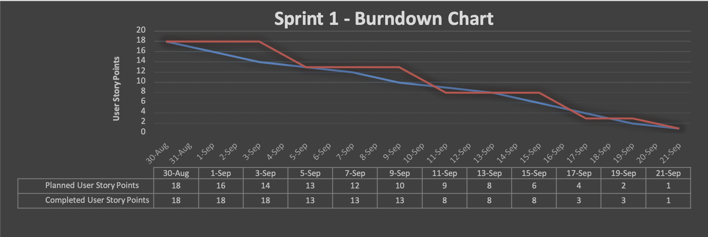
Sprint 1 Burndown Chart

Slide 18
Sprint 2 Artifacts
Type | Description | Priority | Status | Story Points
US-3 | As an admin, once successfully logged in I should be able to view options to add student/ view registered students or check reports | Highest | Completed | 8
US-4 | As an admin I want to access the student registration page to add/register the students into the database to maintain the student's registration details | High | Completed | 8
Task | Design/Search for icons to be used on admin options page and student registration page | Highest | Completed | N/A
Task | Setup MySQL Database | High | Completed | N/A
Task | Add login authentication for admin account | Highest | Completed | N/A
Task | Research Python PyQt GUI toolkit framework | High | Completed | N/A
Task | Create Deliverable 2 Presentation Slides | Medium | Completed | N/A
Number of User Stories Completed – 2
Number of Tasks Completed – 5
Artifacts Completed = 100%
Velocity = 16

Slide 19
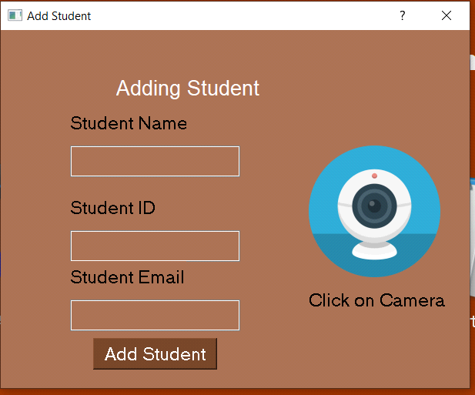
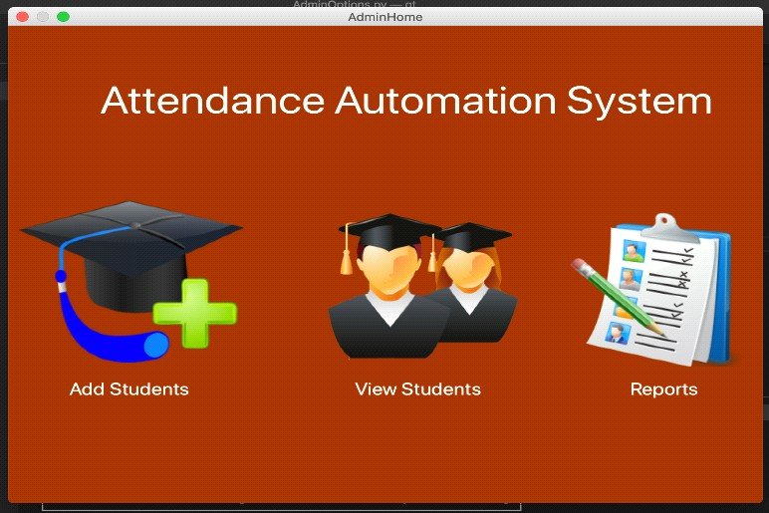
Sprint 2 Deliverables
We added login authentication for admin to access admin options providing options to add/view students or access reports
We completed designing Student registration page which can be accessed once admin logins and clicks on add students

Slide 20
Sprint 2 TEST CASES:
Key | Scenario | Test Case | Expected Result | Actual Result
US - 3 | Admin Login | Admin should be able to provide username and password to login to admin account | - Admin options page should be displayed if valid credentials are provided | Pass
US - 3 |  | If wrong credentials are provided, then invalid credentials message should be displayed | - Displayed message to provide valid credentials message and deny access to account | Pass
US – 4 | Admin options page | Click on add student to access student registration page | - Student registration page should be displayed providing options for student registration details | Pass

Slide 21
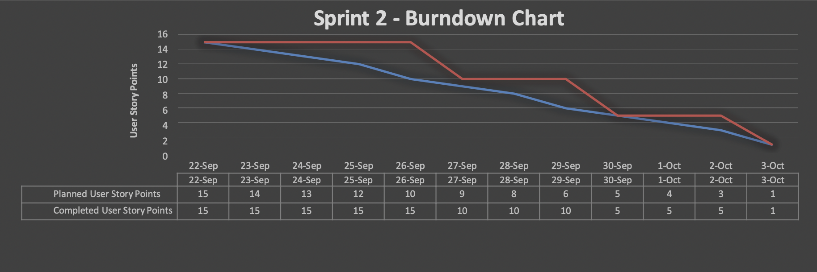
Sprint 2 Burndown Chart

Slide 22
Sprint 3 Artifacts
Type | Description | Priority | Status | Story Points
US-3 | As an admin, I want to design a Database where we store all the user data (Admin, Faculty and Student private data) | Highest | Completed | 8
US-10 | As a faculty, I want to register as a faculty providing required personal details. | High | Moved to Sprint 4 | 8
Task | Create database tables required to store all user data | High | Completed | N/A
Task | Create IEEE Style technical paper (Deliverable 3) | Highest | Completed | N/A
Number of User Stories Completed – 1
Number of Tasks Completed - 2
Artifacts Completed =75%
Velocity = 8

Slide 23
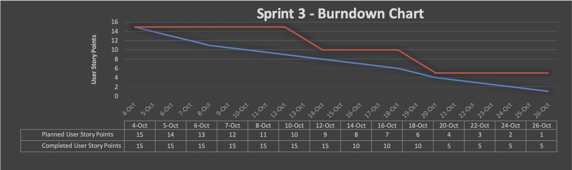
Sprint 3 Burndown Chart

Slide 24
Sprint 4 Artifacts
Type | Description | Priority | Status | Story Points
US-6 | As a faculty, I would like to access the login page to the application using username and password given during the faculty registration | Highest | Completed | 4
US-8 | As an admin, I should be able to add and view registered student’s information in database provided during student registration | Highest | Completed | 8
US-10 | As a faculty, I want to access the registration page as a faculty providing required personal details. | High | Completed | 4
Task | Integrate OpenCV library to be able to access system camera to capture image | Highest | Completed | N/A
Task | Design/Search icons to be used and integrate them for student and faculty registration pages | High | Completed | N/A
Task | Create Deliverable 4 Presentation Slides | High | Completed | N/A
Number of User Stories Completed – 3
Number of Tasks Completed – 3
Artifacts Completed =100%
Velocity = 16

Slide 25
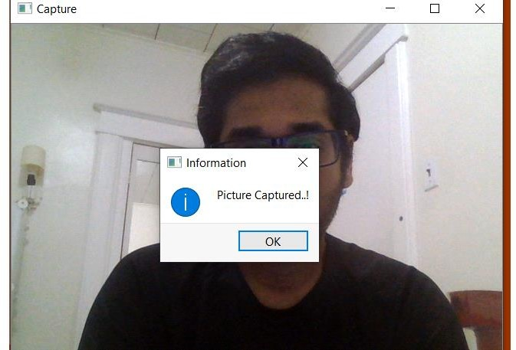
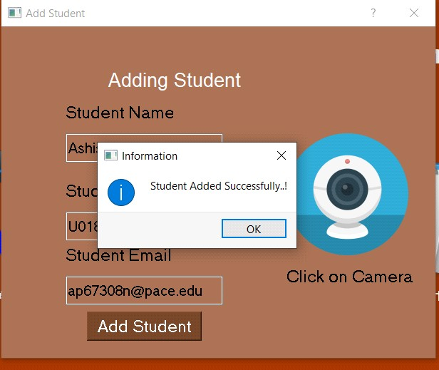
Sprint 4 Deliverables
We have integrated python’s OpenCV library to be able to access system camera to capture and store the image submitted during the registration of the student
We have completed adding capability to capture image and adding student to the database provided with necessary details

Slide 26
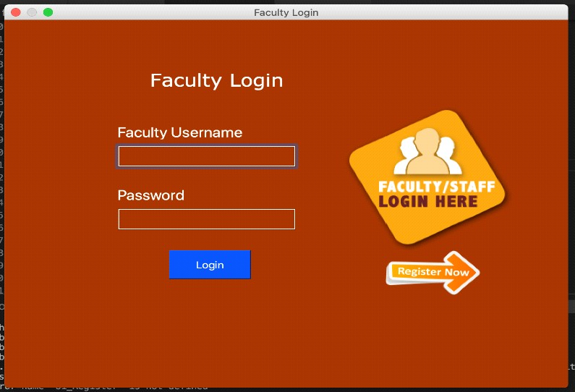
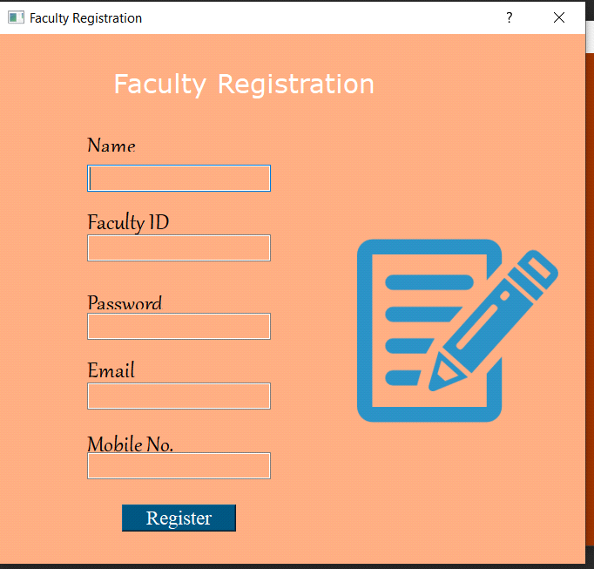
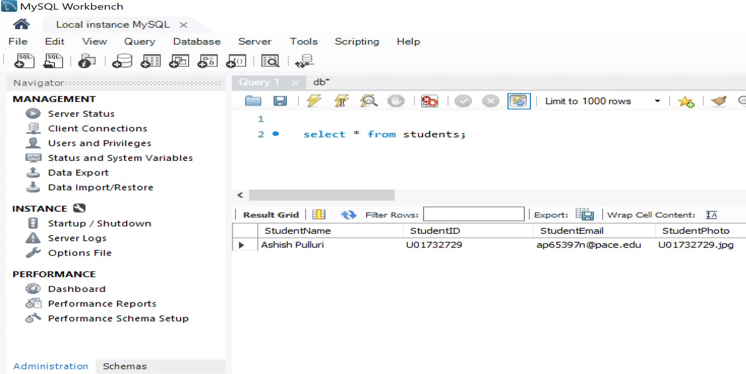
Sprint 4 Deliverables
Database showing student details provided during the student registration
We have also completed designing the faculty login page
Following by the faculty registration page during sprint 4

Slide 27
Sprint 4 TEST CASES:
Key | Scenario | Test Case | Expected Result | Actual Result
US – 8 | Student registration page | Enter student name, student id, student email, capture image | Student should be added successfully to the database in student’s table | Pass
US – 8 | Student registration page | - If null details are entered into the form If student image is not captured Click on camera to invoke system camera If all details are entered and image is captured | - Display error message to provide all the details Display error message to capture student image System camera should be invoked - Display alert student is added successfully | Pass
US – 10 | Faculty Registration Page | Click on register now icon to redirect to faculty registration page | - Faculty registration page should be displayed | Pass
US – 6 | Faculty login page | User should be able to click on faculty icon on home page to open faculty login page with option to register if new user | Faculty login page should be displayed | Pass

Slide 28
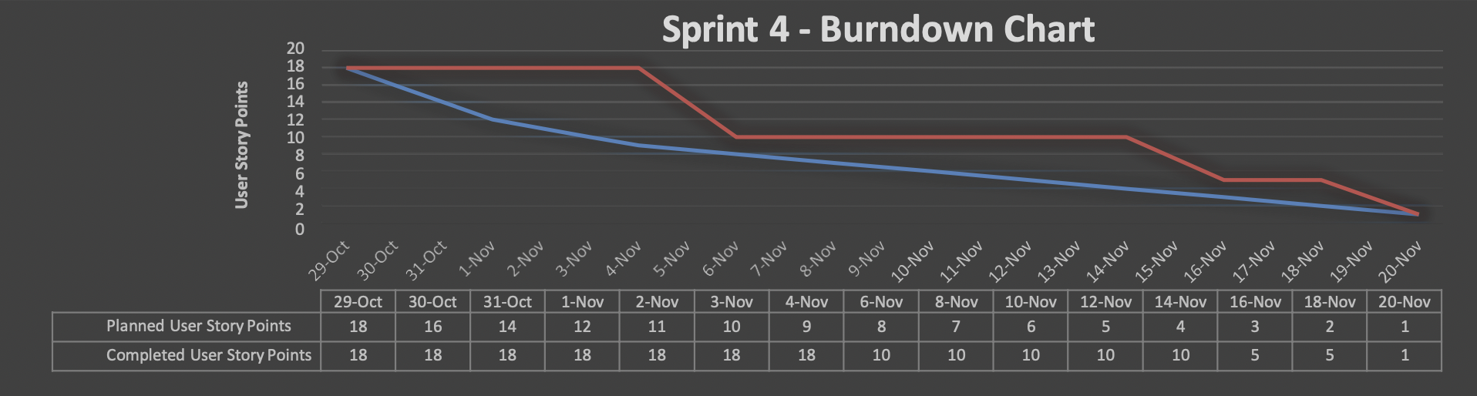
Sprint 4 Burndown Chart

Slide 29
Sprint 5 Artifacts
Type | Description | Priority | Status | Story Points
US-7 | As a Faculty, I want to register as a faculty to be able to have a secure login to my account | Highest | Completed | 4
US-9 | As a Faculty, I want to have a secure login using username and password to access my account to take attendance/view reports | Highest | Completed | 4
US-11 | As a faculty, I want to access options available to capture attendance/browse an image to upload for attendance or view reports | High | Completed | 8
Task | Develop attendance options page and faculty options page | Highest | Completed | N/A
Task | Design/Search icons to be used and integrate them for faculty options page and attendance options page | High | Completed | N/A
Task | Update Technical Paper for Sprint 5 | Medium | Completed | N/A
Task | Create Deliverable 5 Presentation Slides | High | Completed | N/A
Number of User Stories Completed - 3
Number of Tasks Completed – 3
Artifacts Completed =100%
Velocity = 16

Slide 30
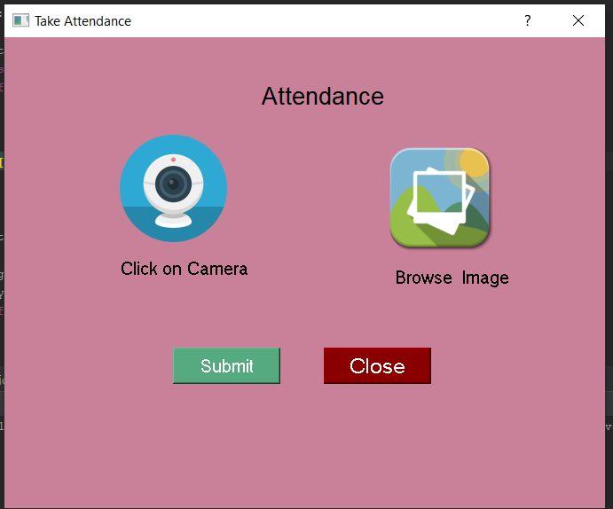
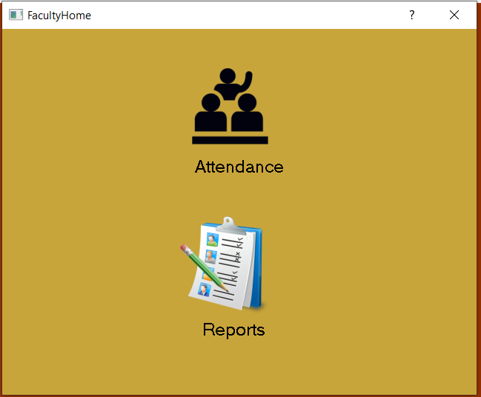
Sprint 5 Deliverables
We have added registration and login authentication for faculty and faculty can now login to their account using the credentials provided during the registration
We have also completed designing the faculty home page and attendance options page
We added capability to store the students image captured /uploaded by faculty which can be used by machine learning algorithm to perform face recognition to recognize the students

Slide 31
Sprint 5 TEST CASES:
Key | Scenario | Test Case | Expected Result | Actual Result
US- 7 | Faculty Registration | Enter all the required fields name, email id, password, phone number | - User should be able to successfully register and display successfully registered message | Pass
US - 7 |  | Fields should not be empty and All the fields need to be provided to successfully register | Display fields cannot be empty if any field is not entered successfully | Pass
US - 9 | Faculty Login | Sign in using the valid username and password provided During registration | - User should be able to successfully login with their credentials | Pass
US - 11 | Faculty options Page | Immediately after login faculty should be able to see options to capture attendance/ browse image to upload options | - Display capture attendance/ browse image to upload options to faculty after the sign in | Pass
US - 11 |  | Should be able to click on capture attendance icon to open the system camera | - System camera should be invoked and able to capture the image | Pass
US - 11 |  | Should be able to click on image upload to browse an image available in the system | Display files available to upload an image available in the user's system | Pass

Slide 32











Sprint 5 - Burndown Chart
14
12
10
8
6
4
2
0
Number of Tasks
 | 27-Jan | 3-Feb | 8-Feb | 12-Feb | 20-Feb
Expected Burndown | 13 | 10 | 8 | 5 | 0
Actual Burndown | 13 | 10 | 10 | 8 | 0
Sprint 5 Burndown Chart

Slide 33
Sprint 6 Artifacts
Type | Description | Priority | Status | Story Points
US-12 | As a Faculty/Admin, I want the application to detect the students face and display the name of the student present for attendance | Highest | Completed | 8
US - 15 | As a Faculty/ Admin, I want to view attendance reports generated after the student attendance is updated on the GUI Console | High | Moved to Sprint 7 | 5
US-13 | As an Admin, I should be able to access and view registered students on GUI console after login | Highest | Completed | 8
Task | Research about integrating KNN Machine learning algorithm and python’s face recognition library | Highest | Completed | N/A
Task | Update Technical Paper for sprint 6 | High | Completed | N/A
Task | Create Deliverable 6 Presentation Slides | High | Completed | N/A
Number of User Stories Completed – 2
Number of Tasks Completed – 3
Artifacts Completed =83%
Velocity = 21

Slide 34
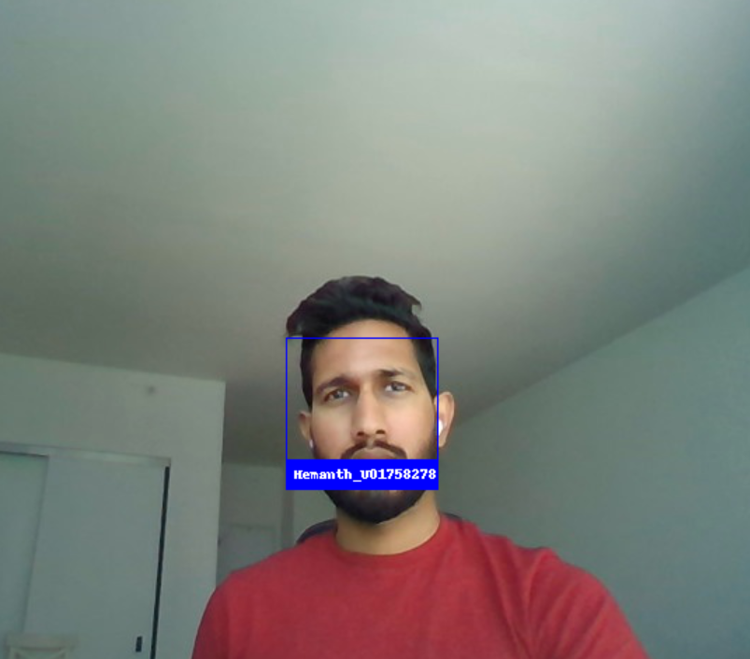
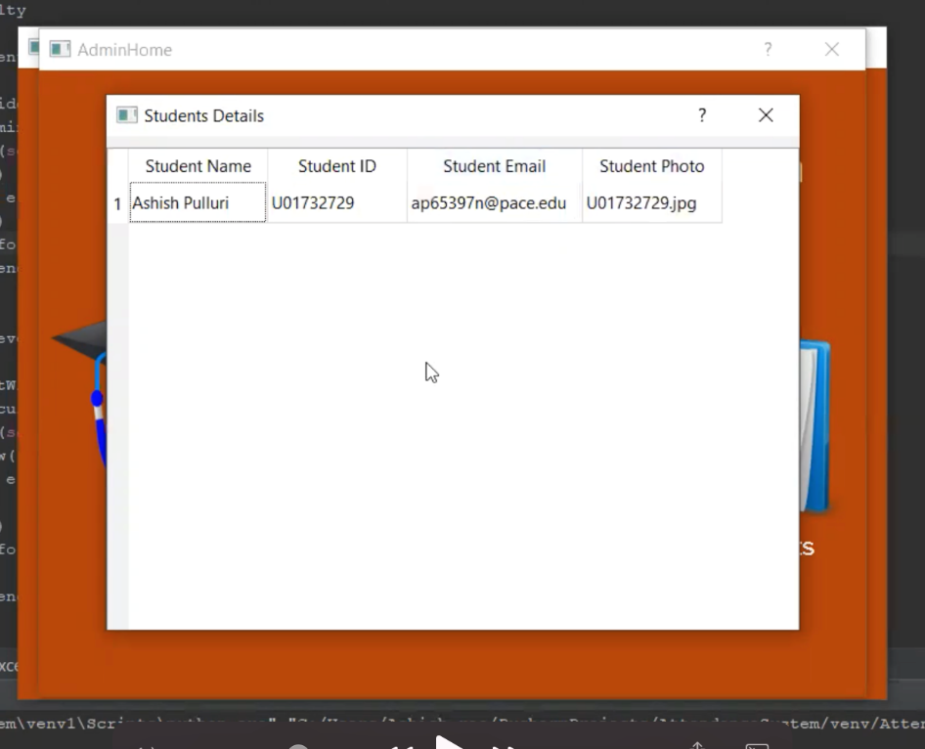
Sprint 6 Deliverables
We added a new capability by integrating KNN Machine learning algorithm to our application which will be able to detect the student face registered in the database and display the student’s Name and ID
We added capability to store the students image captured /uploaded by faculty which can be used by machine learning algorithm to perform face recognition to recognize the students

Slide 35
Sprint 6 TEST CASES:
Key | Scenario | Test Case | Expected Result | Actual Result
US – 12 | Faculty options Page | Should be able to click on capture attendance icon to open the system camera | -System camera should be invoked and should be able to take a photo | Pass
US – 13 | Display registered students on GUI console | Admin should be able to click on view students in the GUI console to view all the registered students | GUI Console should display all the registered student details including name, student ID, email and student image number | Pass
US – 12 | Detect registered student face | Faculty should be able to capture/upload image and click submit to successfully submit attendance | Display attendance successfully captured message | Pass
US – 12 | Detect registered student face | KNN Machine learning algorithm should be able to detect the student face from the registered student's data stored in the database | Faculty should be immediately able to see the student's image who are present with their names recognized from the database. | Pass

Slide 36
Sprint 6 Burndown Chart

Slide 37
Sprint 7 Artifacts
Type | Description | Priority | Status | Story Points
US - 14 | As a Faculty/Admin, I want to access the options available to either view the current day attendance/ Download consolidated attendance for entire month | Highest | Completed | 5
US - 15 | As a Faculty/ Admin, I want to view attendance reports generated after the student attendance is updated on the GUI Console | Highest | Completed | 5
US - 16 | As a Admin/Faculty, I want to download attendance reports once the attendance is captured and submitted | Highest | Completed | 5
Task | Update Technical Paper for sprint 7 | High | Completed | N/A
Task | Create Deliverable 7 Presentation Slides | High | Completed | N/A
Number of User Stories Completed – 3
Number of Tasks Completed – 3
Artifacts Completed =100%
Velocity = 15

Slide 38

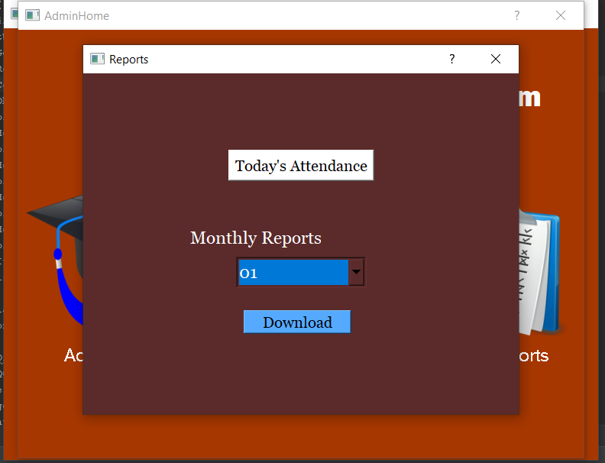
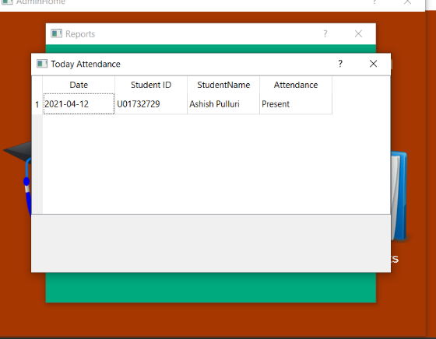
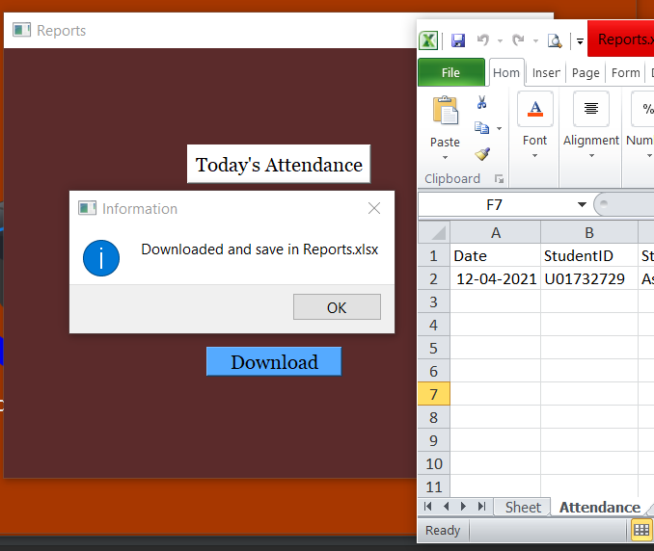
Sprint 7 Deliverables
Admin/Faculty can now access reports option page to view today’s attendance/Download consolidated attendance for the current month or previous months
The Admin/Faculty can now view the attendance report in the GUI Console immediately once attendance is captured & submitted by faculty by accessing the report options page(bottom-left)
A new capability to download the attendance result in excel format has been added by using OpenPyXl python library which can be used to read/write data to the excel sheets
The admin and faculty can download the attendance reports generated immediately after attendance is submitted.(bottom-right)

Slide 39
Sprint 7 TEST CASES:
Story Number | Scenario | Test Case | Expected Result | Actual Result
US – 14 | Access attendance reports | Admin should be able to click on reports in admin options page to access reports page to view/download reports | Attendance reports page should be displayed to the admin | Pass
US – 14 | Access attendance reports | Faculty should be able to click on reports in faculty options page to access reports page to view/download reports | Attendance reports page should be displayed to faculty | Pass
US – 15 | View attendance reports | Admin/Faculty should be able to click on today’s attendance to view attendance report generated today on GUI Console | Admin/Faculty should be able to view student’s attendance report captured today with list of students who are present and absent | Pass
US - 15 | View attendance reports | Attendance report on GUI Console should display complete student details with attendance | Date, student id, student name and attendance status should be displayed | Pass
US – 16 | Download attendance reports | Admin/Faculty should be able to click on download to successfully download data in excel sheet | Downloaded and saved in reports.xlsx message should be displayed | Pass
US – 16 | Download attendance reports | Admin/Faculty should be able to to access the student's attendance reports in excel format | Admin/Faculty should be able to download excel sheet with consolidated attendance data | Pass
US - 16 | Download attendance reports | Downloaded excel sheet should display complete student details with attendance status | Date, Student ID, Student name and attendance status present/absent should be displayed | Pass

Slide 40
Sprint 7 Burndown Chart

Slide 41
Sprint 8

Slide 42
Sprint 8 Artifacts
Type | Description | Priority | Status | Story Points
US - 17 | As a Faculty, I want to receive the email to my registered email id with the list of students who are absent for the class immediately once attendance is captured and submitted | Highest | Completed | 8
US - 18 | Complete Redesign of attendance automation system | Highest | Completed | 5
US - 19 | As a Faculty/Admin, I want the application to be available as a executable file so that it is easier to deploy and start using the app | High | Completed | 5
Task | Integrate smtplib python library and configure the base email address to be used for app to send attendance emails to faculty | Highest | Completed | N/A
Task | Completely redesign the attendance automation system with more user-friendly design colors and icons for all the modules | High | Completed | N/A
Task | Convert the main.py python file to executable file(.exe) using pyinstaller | High | Completed | N/A
Task | Update technical paper for sprint 8 | Medium | Completed | 1
Task | Update wikipage on GitHub | Medium | Completed | 2
Task | Update User Manual | Medium | Completed | 2
Task | Prepare presentation slides for sprint 8 | Medium | Completed | 2
Task | Improvement Action Item(Sprint 7 Feedback) | High | Completed | 2

Slide 43
Sprint 8 Statistics
Number of User Stories Completed - 3
Number of Tasks Completed – 8
Velocity = 18
Artifacts Completed = 100%

Slide 44
Committed and Completed Artifacts
ID | User Story | Acceptance Criteria | Story Priority | Story Points
US - 17 | As a Faculty, I want to receive the email to my registered email id with the list of students who are absent for the class immediately once attendance is captured and submitted | Given that the Faculty is on the attendance options Page, when the faculty captures the image and submits the attendance an email should be automatically sent to the registered email id with the list of students who are absent for the class | Highest | 8
US - 18 | As a Faculty/ Admin, I want the application to be very user friendly | Given that the application is launched by either faculty/admin the application should be displayed with more user-friendly design colors and icons for all the pages and modules of the application | Highest | 5
US-19 | As a Faculty/Admin, I want the application to be available as a executable file so that it is easier to deploy and start using the app | Given that the faculty/admin when try to use the application can click on the executable file to launch the application instead of running the python script through IDE | High | 5
Issue Type | Summary | Task Priority
Task | Integrate smtplib python library and configure the base email address to be used to send attendance emails to faculty | Highest
Task | Completely redesign the attendance automation system with more user-friendly design colors | High
Task | Update the application icons for all modules of the application | High
Task | Convert the main.py python file to executable file(.exe) using pyinstaller | High
Task | Update technical paper for sprint 8 | Medium
Task | Update wikipage on GitHub | Medium
Task | Update User Manual | Medium
Task | Prepare presentation slides for sprint 8 | Medium
Task | Improvement Action Item(Sprint 7 Feedback) | High

Slide 45
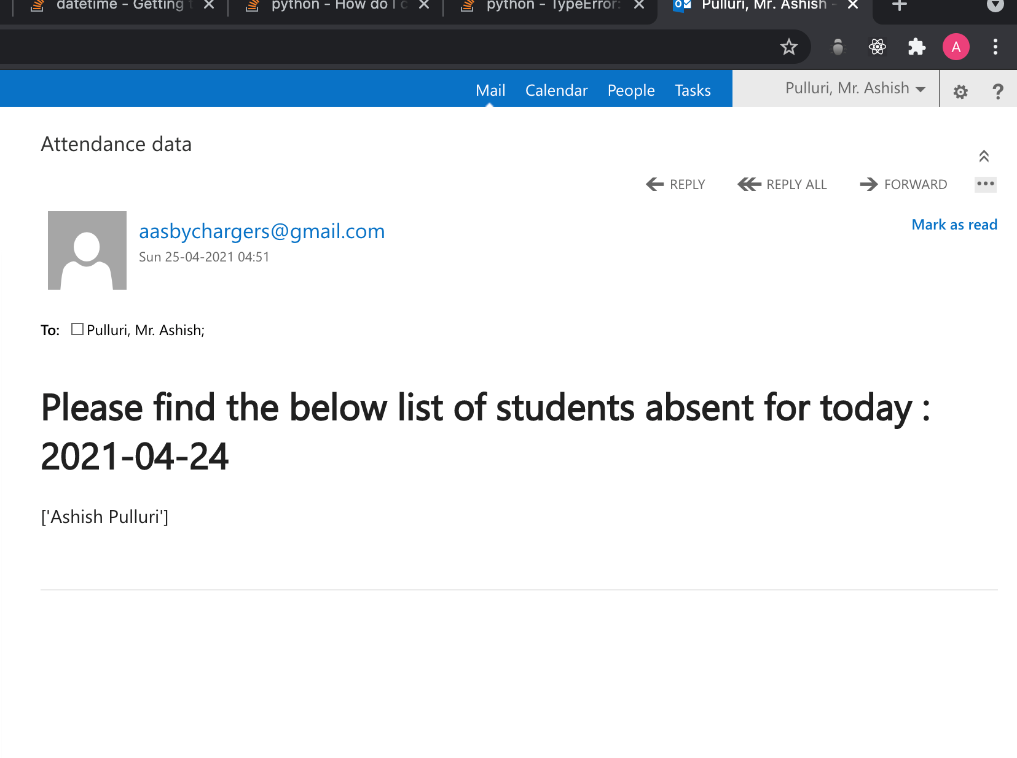
SPRINT 8 - Deliverable 1
Email Attendance result data if student is absent
- We added a new capability to send emails using python’s smtplib library which can be used to send emails automatically once faculty captures and submits the attendance image

Slide 46
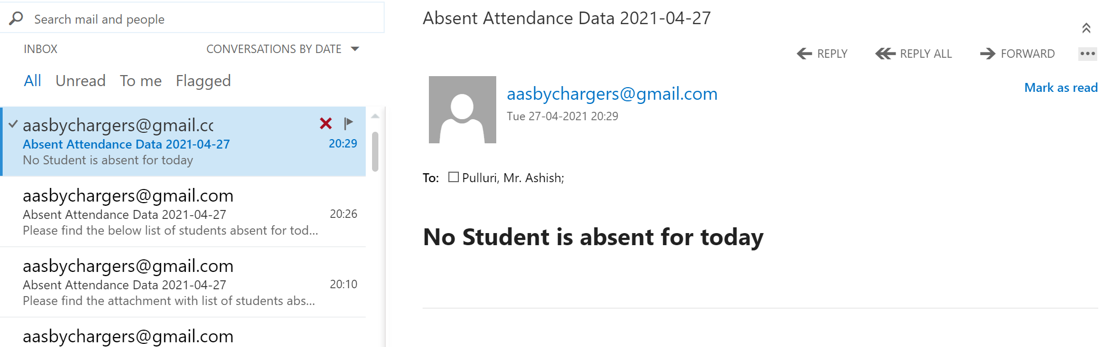
SPRINT 8 - Deliverable 2
Email Attendance result data if all students are present
If all the students are present while attendance is captured and once machine learning algorithm detects all the students registered and if no student is absent the following email would be sent to the registered faculty

Slide 47
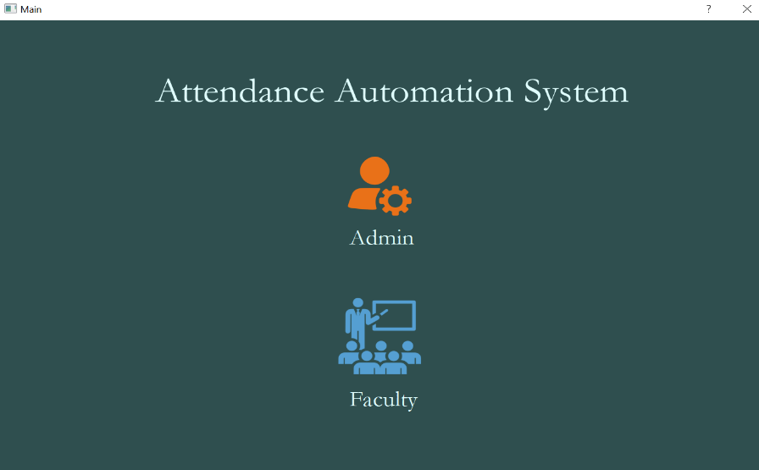

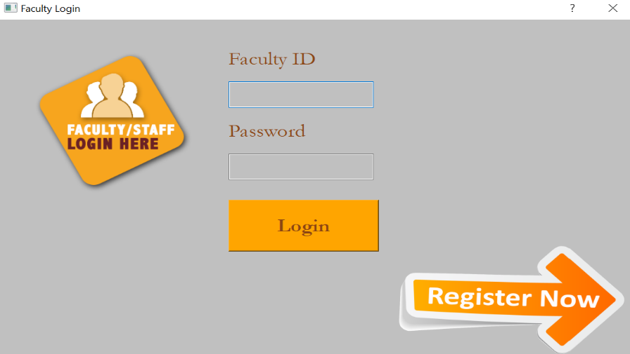
SPRINT 8 – Deliverables
Before
After

Slide 48
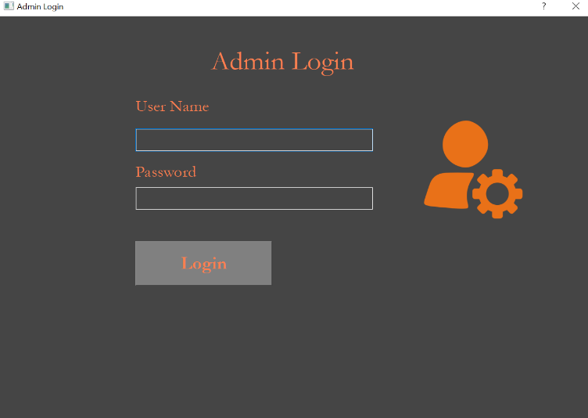
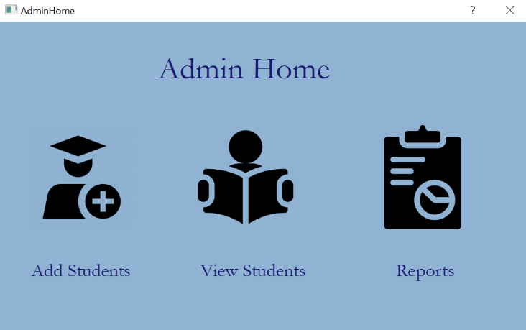
SPRINT 8 – Deliverables
Before
After

Slide 49
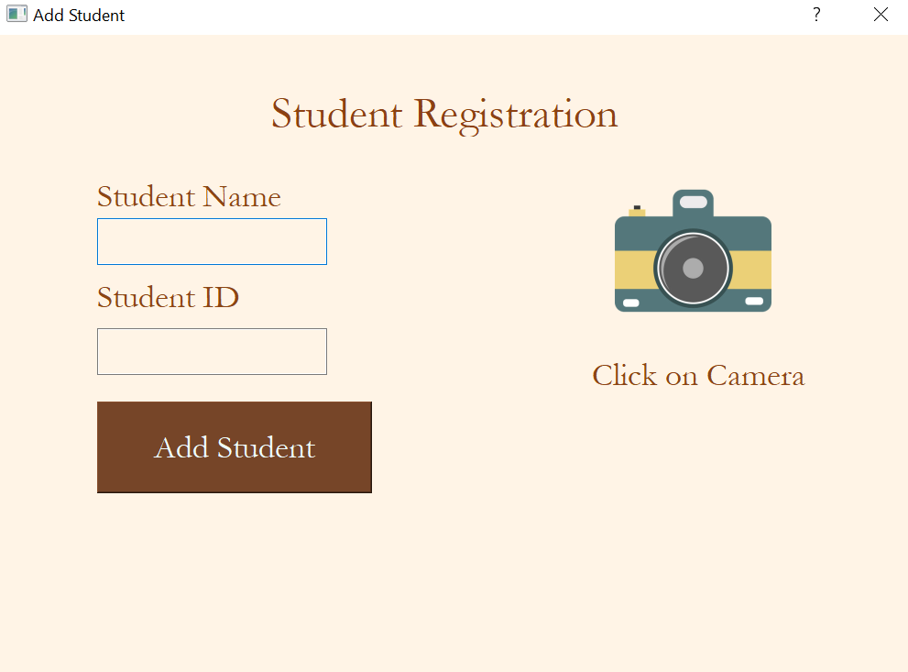
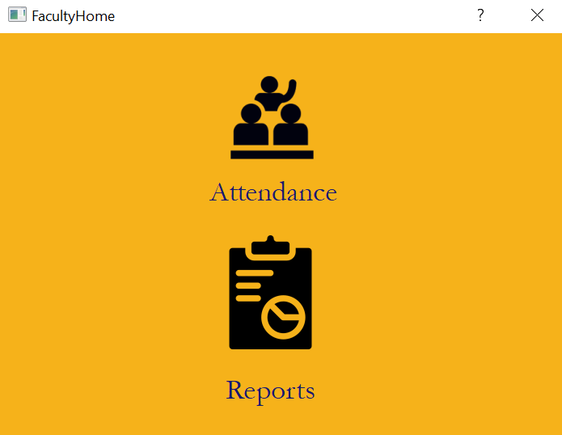
SPRINT 8 – Deliverables
Before
After

Slide 50
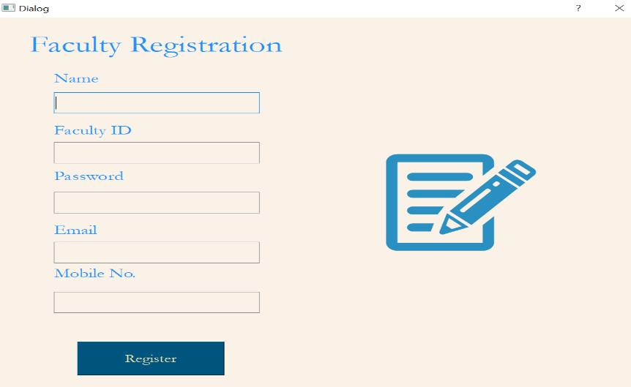
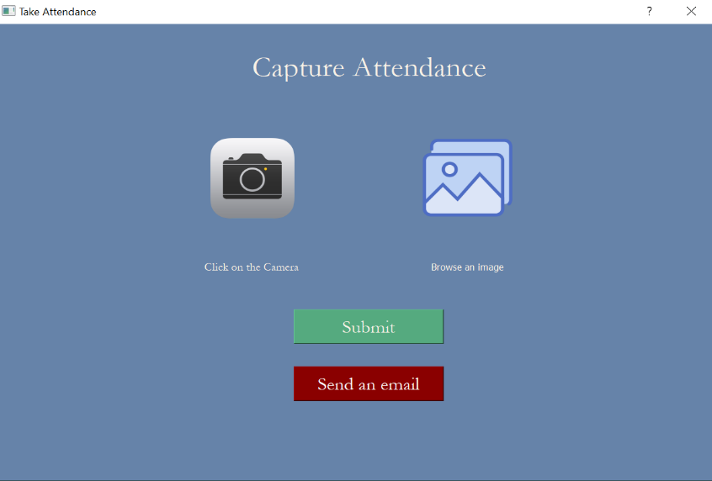
SPRINT 8 – Deliverables
Before
After

Slide 51
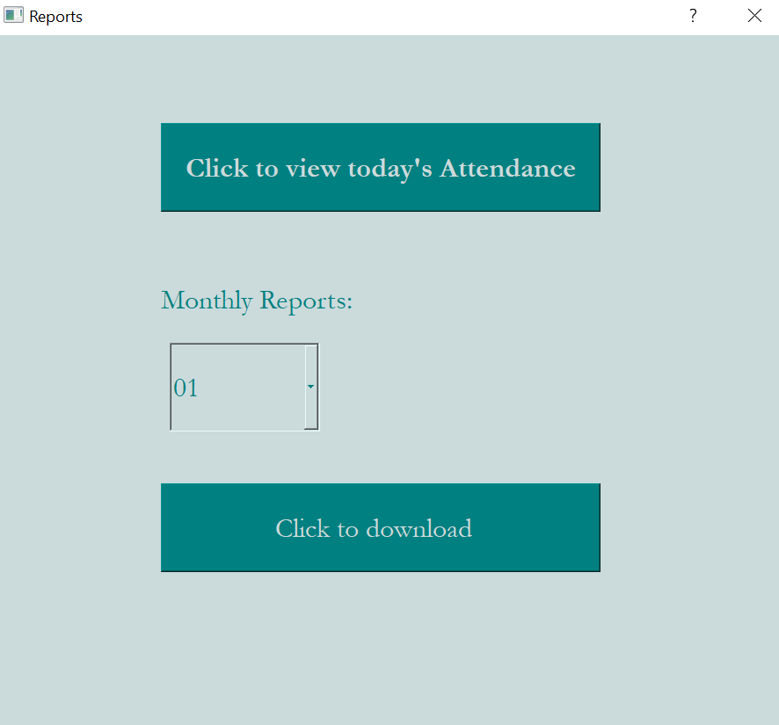
SPRINT 8 – Deliverable
Before
After

Slide 52
Sprint 8 TEST CASES:
Story Number | Scenario | Test Case | Expected Result | Actual Result
US – 17 | Email to registered faculty | Once faculty clicks on send an email success message should be displayed | Attendance submitted and email sent message should be displayed | Pass
US – 17 | Email to registered faculty | When clicked on send email an email with absent list should be sent to registered faculty id | Absent list for the present date should be received by faculty | Pass
US – 18 | Redesign UI interface | Redesigned applications icons should be displayed for all pages of application | All the pages of applications are updated with user friendly colors and icons | Pass
US - 19 | Create exe file | Converted exe file should be able to start the application | Application is launched when user clicks on main.exe file | Pass

Slide 53
Sprint 8 Burndown Chart

Slide 54
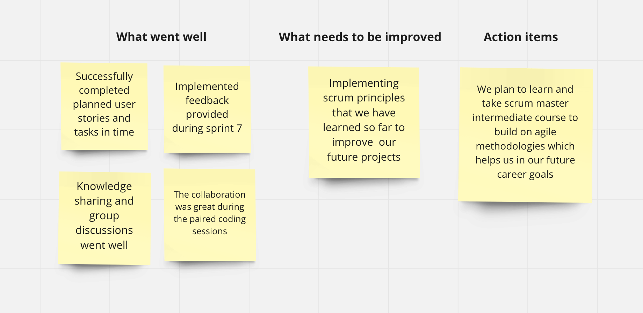

Sprint Retrospective

Slide 55



Story Points Timeline
Sprint
18
Story points
16
Sprint
16
Sprint
16
Sprint
16
Sprint
16
Sprint
Story points
Story points
Story points
Story points
15
Sprint
Story points
Story points
08
Sprint
Story points
Sprint 1
Sprint 2
Sprint 3
Sprint 4
Sprint 5
Sprint 6
Sprint 7
Sprint 8

Slide 56

Future Scope?
Migrating and managing entire tool on cloud platform.
Hosting Attendance Automation System tool on an entirely separate setup build for the application.
Integrating Automation Attendance System tool to a mobile application and enhancing to cater future needs.

Slide 57
Thank You
The golden rule for every businessman is this: Put yourself in your customer’s place.“
- Orison Swett Marden

